Slide 1
Embedded System Laboratory
2020 Summer Training
Lecture 3: Timer & Interrupt
Made by 許家偉 2020/7

Slide 2
Outline
Introduction of Interrupt
Introduction of Timer
Exceptions in ARM_v8
Implementation

Slide 3
Introduction of Interrupt
What is “Interrupt”?
An event that requires the CPU to stop normal process execution and perform some service.
Usually generated by hardware (although they can be initiated by software).
Often indicate that an event has occurred that needs an urgent response.
Interrupts may occur at any time.
Notes:
需要CPU停下手邊正在做的事情 轉而去處理其他事件
硬/軟體可觸發
通常為必須馬上處理/回應的請求

Slide 4
Introduction of Interrupt
Before we have interrupts, the technique we used is:
Busy Waiting.(Polling)
- A process repeatedly checks to see if a condition is true.
But now we use interrupts.
In systems programming, an interrupt is a signal to the processor emitted by hardware or software indicating an event that needs immediate attention.
-Wikipedia, the savior of teaching assistants
Notes:
或者又叫 polling
可以由硬體或軟體來觸發
目的是處理必須馬上處理的事件

Slide 5


Introduction of Interrupt is interrupt
Busy waiting is just like…
The keypad
And it’s our CPU

Slide 6


Introduction of Interrupt
An interrupt is just like…
An emergency happened, Your Majesty
Ok, I’m going to handle it.

Slide 7
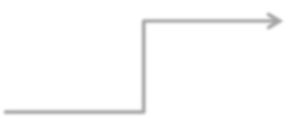
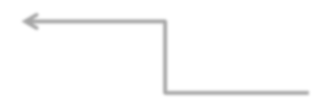
Introduction to Interrupt
When an interrupt occurs, the processor :
Save current status (reg. data, return address)
Goto interrupt service routine
Fininshed, back to original execution
main( ){
Interrupt service routine(ISR)
while(true){
Interrupt
program
}
Notes:
Low priority interrupts are not processed while high priority interrupts are in progress.

Slide 8
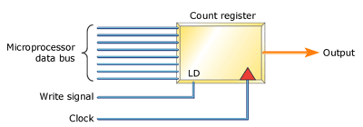
Introduction of Timer
The counter increases its value by 1 after each clock tick
When counter is equal to compare register, the interrupt occurs
Notes:
需要CPU停下手邊正在做的事情 轉而去處理其他事件
硬/軟體可觸發
通常為必須馬上處理/回應的請求

Slide 9
Exceptions in ARM_v8
4 types of exception
Synchronous exception
software interrupt , ex: store data at an unexistent memory location
IRQ (Interrupt Request)
Asynchronous interrupts , generated by external hardware
FIQ (Fast Interrupt Request)
Prioritizing IRQ
SError (System Error)
Indicates error condition generated by external hardware
Notes:
Synchronous exception Exceptions： 這種例外通常是被當前執行的指令造成。例如： 你可以使用 str 指令去儲存一些 data 在不存在的記憶體空間。 在這個 case 裡，一個同步的例外會被產生，同步例外會被用來產生軟體中斷，是藉由 svc 指令來產生的軟體中斷（也稱作 synchronous exception），將在後面提及。
IRQ (Interrupt Request)： 這個是正常中斷，他們是非同步的，意思是他們與當前指令無關，和 synchronous exceptions 比起來，他們並不是被處理器產生的，而是透過外部硬體去控制。 p109
FIQ (Fast Interrupt Request)： 這個類型的中斷叫作快速中斷， 是為了例外優先順序而存在的。如此一來他可以分辨這個例外是正常還是快速。 快速中斷再發出第一個訊號後，將由一個 separate exception handler 來處理。Linux 裡沒有使用 Fast Interrupt 這個結構。
SError (System Error)： 系統錯誤也像 IRQ 和 FIQ，是由外部硬體發出非同步中斷。但又不同於 IRQ 和 FIQ，SError 會指出一些錯誤條件。 例子

Slide 10
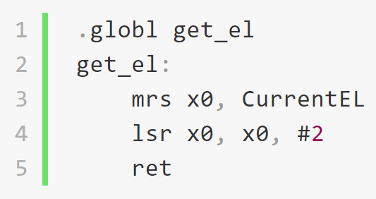
Exceptions in ARM_v8
4 exception levels
EL0
User process
EL1
Guest OS level
EL2
Host OS level
EL3
Hardware level
CurrentEL register

Slide 11
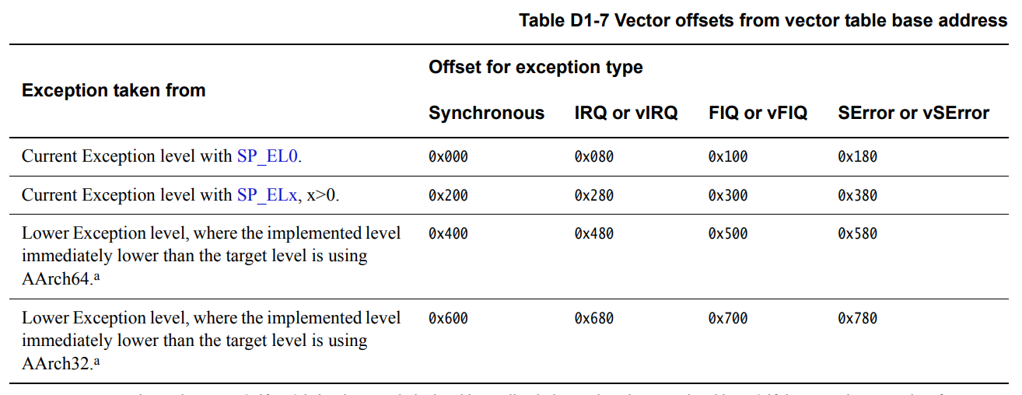
Exceptions in ARM_v8
16 exception handlers
Notes:
每個例外類型都需要有自己的 handler。 個別的 handlers 應該要被定義再不同的執行狀態，這裡有4個執行狀態，如果執行在 EL1 就必須了解它們：
Comment
EL1t Exception 是 EL1 的 stack pointer 是和 EL0 一起共享時。這個會發生在 SPSel 暫存器值是 0 時。
EL1h Exception 是發生在 EL1 貢獻 stack pointer 是分配給 EL1，這個會發生在 SPSel 暫存器值是 1 時，也就是我們要使用的狀態。
EL0_64 Exception EL0 執行在 64-bit 模式
EL0_32 Exception EL0 執行在 32-bit 模式

Slide 12
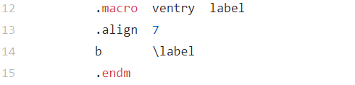
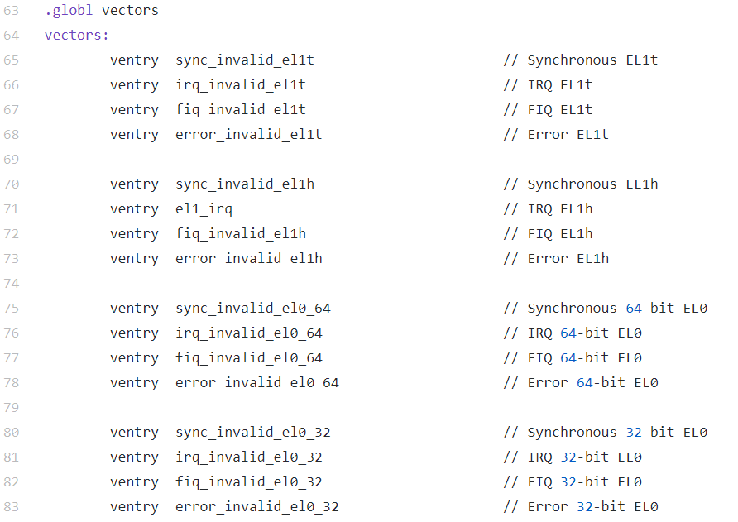
Implementation
Interrupt vector table
Each offset is 0x080 = 2^7
Notes:
首先先寫一個可以進入 exception vector 的 macro，至於這裡 .align 7 的原因， 是因為每個例外長度都為 0x80 bytes， 換算成 10 進位就是 128，而 2^7 也恰好等於 128

Slide 13
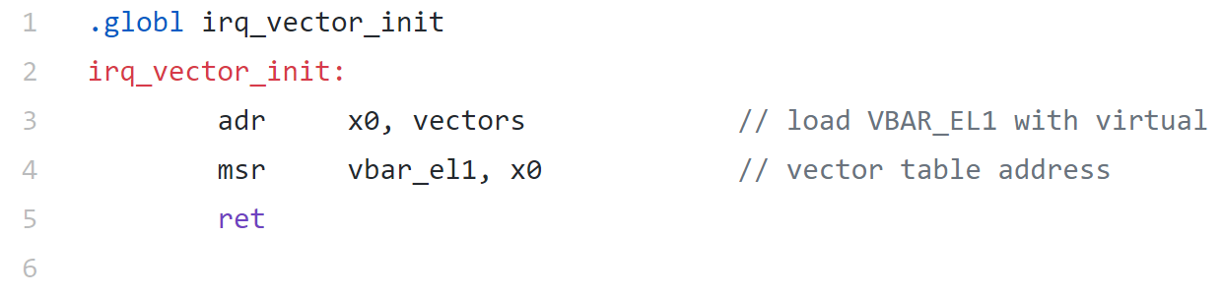
Implementation
Point to vector table

Slide 14
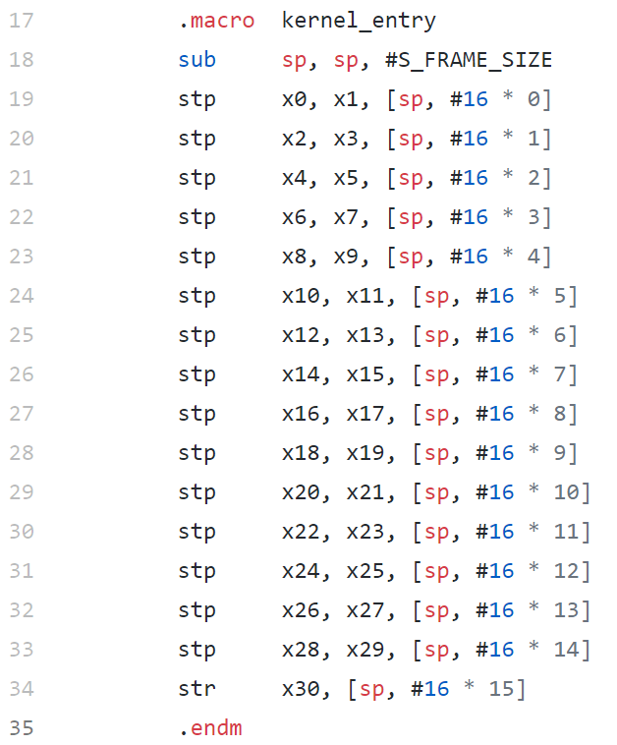
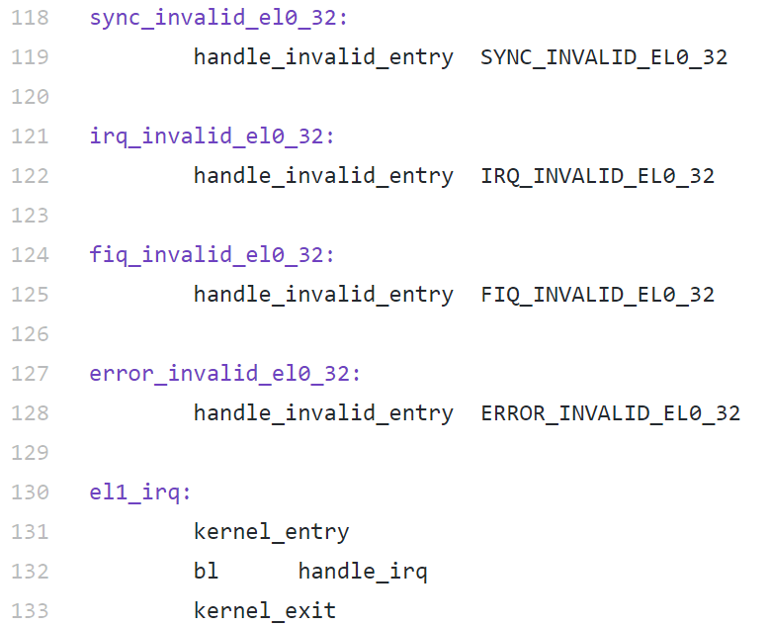
Implementation
Maintain a stack
Store all current regs. before going to ISR
Pop stack after finishing ISR

Slide 15
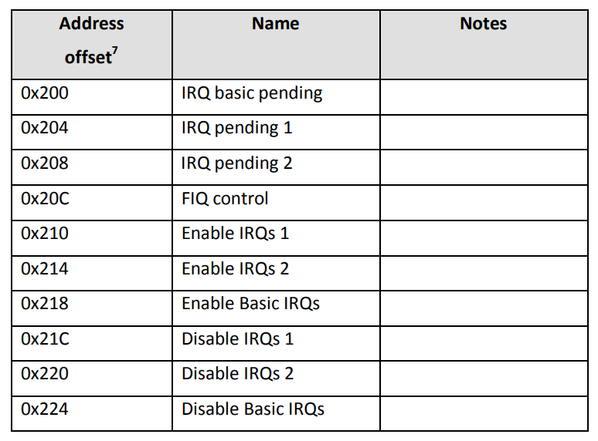
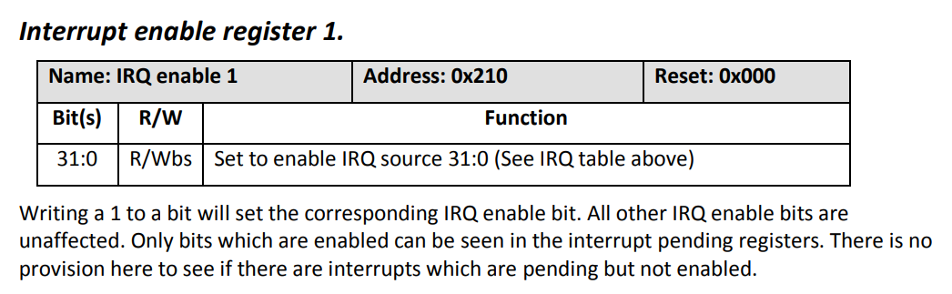
Implementation
Enable IRQ interrupt

Slide 16
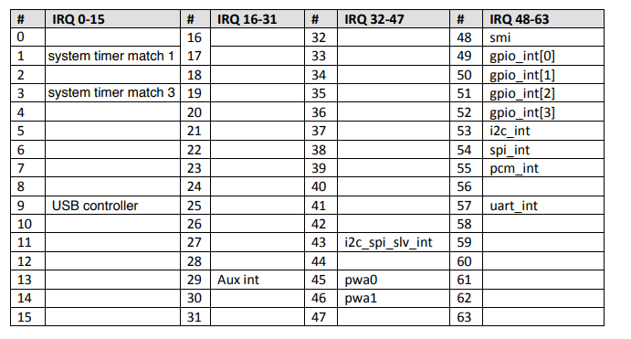
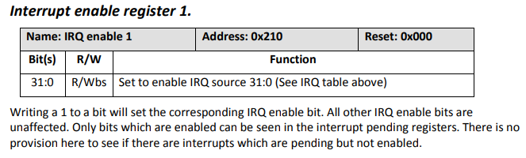
Implementation
Enable timer interrupt
Notes:
我們只能只用timer 1 & 3

Slide 17
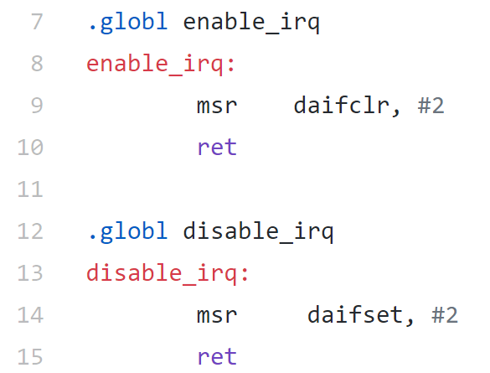
Implementation
Masking/unmasking interrupts
D : Mask debug exceptions
A : Masks SErrors
I : Masks IRQs
F : Masks FIQs
Notes:
ARM processor state has 4 bits that are responsible for holding mask status for different types of interrupts. Those bits are defined as following.
D Masks debug exceptions. These are a special type of synchronous exceptions. For obvious reasons, it is not possible to mask all synchronous exceptions, but it is convenient to have a separate flag that can mask debug exceptions.
A Masks SErrors. It is called A because SErrors sometimes are called asynchronous aborts.
I Masks IRQs
F Masks FIQs
Now you can probably guess why registers that are responsible for changing interrupt mask status are called daifclr and daifset. Those registers set and clear interrupt mask status bits in the processor state.
The last thing you may wonder about is why do we use constant value 2 in both of the functions? This is because we only want to set and clear second (I) bit.

Slide 18
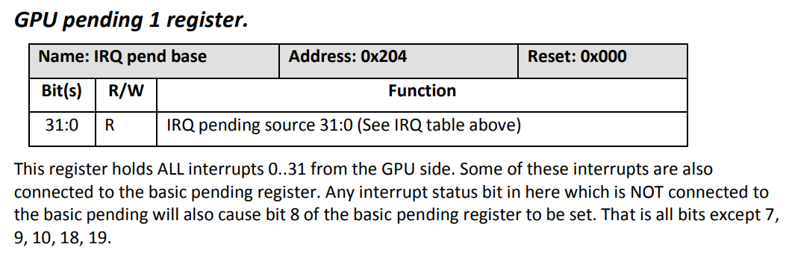
Implementation
When interrupt occurs , the IRQ pending bit will be set.
Check which interrupt occurred
IRQ

Slide 19
Practice time

Slide 20
Homework
Using two timers to control LEDs
Select timer by UART
Timer 1
LEDs blinks one after one (一個接著一個閃爍)
Timer 3
LEDs full light up and down (全部一起亮,全部一起暗)
The two timers should have obvious difference of time interval

